Slide 1
TWITTER TWEET SPAM CLASSIFICATION
Team Members:
Harshini Badam(Z1948598)
Sai Sathwik Vattikuti(Z1946894)
Mandhakini Nallapaneni(Z1981418)

Slide 2
INTRODUCTION
Social network platforms like Twitter, Facebook and instagram have a rapid growth in the industry, sharing various types of content.
Twitter has become one of the most popular microblogging platforms, where users post messages which is referred mostly as tweet.
Spammers take advantage of the implicit trust relationships among users to achieve malicious purposes.
Consequently, numerous academics, as well as Twitter, have recommended different methods of spam detection to make twitter a spam-free platform.

Slide 3
DATA SET
In this project we have considered a dataset from kaggle to perform the analysis.
The attributes of the dataset are :
Tweet - Text that was tweeted by the users
following - Number of people the account that tweeted is following
followers – Number of people following the account that tweeted
actions – Total Number of favorites, replies and retweets of said tweet
is_retweet – if 0 its not retweet, if 1 it is a retweet location – self written location provided by the user
Type – Either Quality or spam

Slide 4
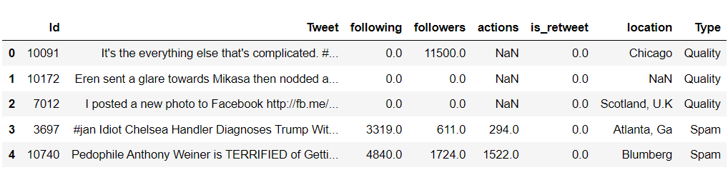

Slide 5
APPROACHES
LSTM and BI-LSTM
Large Language Models (LLM)
Integrating LSTM with LLM

Slide 6
DEEP LEARNING MODELS
Deep learning models are built with ability to understand the sentence semantics to make predictions on the data.
As the meaning of the text is taken into account, the model will be able to make more accurate predictions if it is aware of the sentence's semantics.
From the numerous algorithms, we are considering LSTM model for our purpose as understanding the context is important.

Slide 7
LSTM - LONG SHORT TERM MEMORY
LSTM is a type of Recurrent neural network(RNN) which is specifically designed to handle sequential data, such as speech, text and timeseries data.
It selectively retain or discard information as it flows through the network, which allows them to learn long term dependencies.
It is used in applications like Language modeling, speech recognition, spam classification.

Slide 8
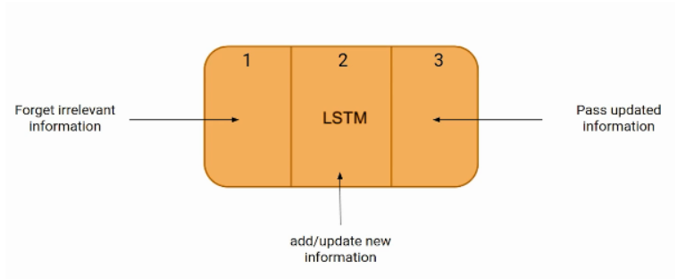
The input gate controls what information is added to the memory cell. The forget gate controls what information is removed from the memory cell. And the output gate controls what information is output from the memory cell.

Slide 9
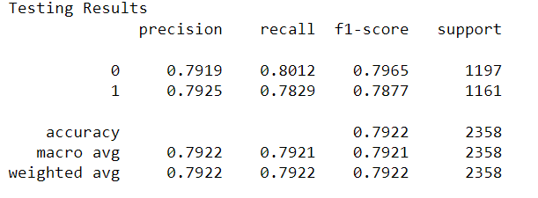
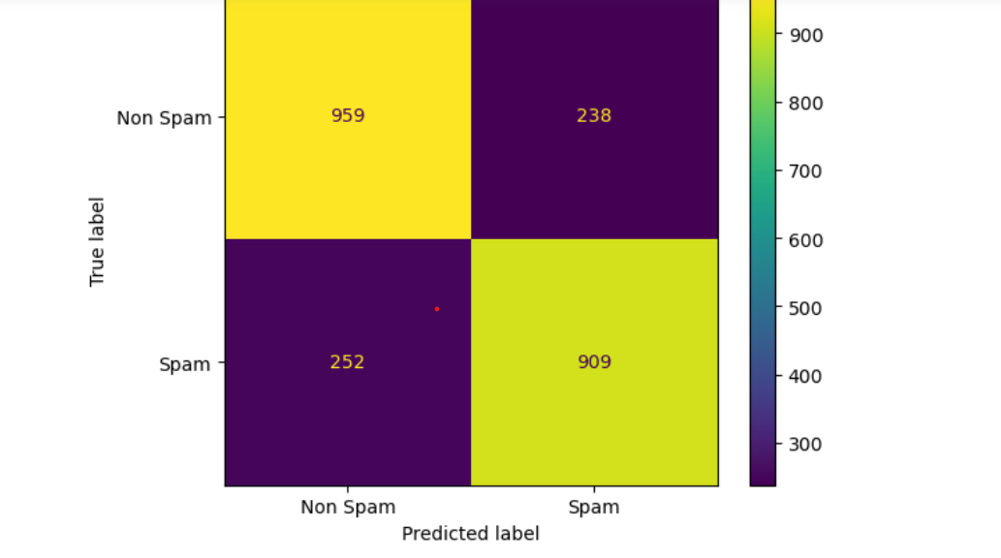

Slide 10
BI-DIRECTIONAL LSTM
A Bi-directional LSTM a powerful tool for modeling the sequential dependencies, which contains two LSTM layers, one for processing input in forward direction and the other for processing in the backward direction.
With this approach by processing data in both directions, the model will be able to better understand the relationship between sequences.

Slide 11
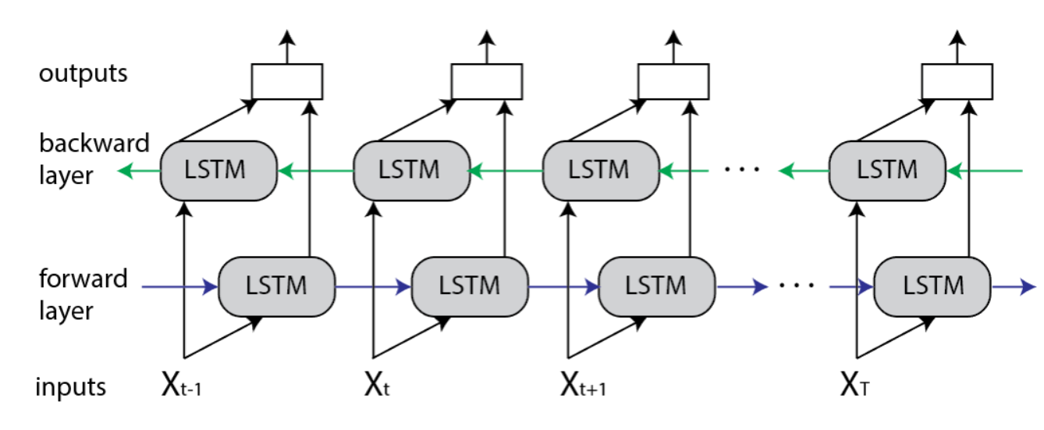

Slide 12
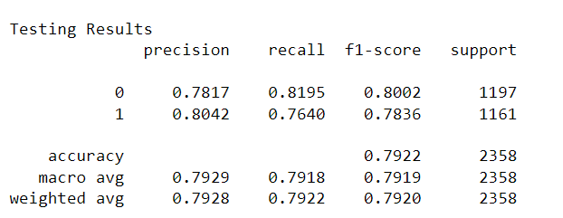
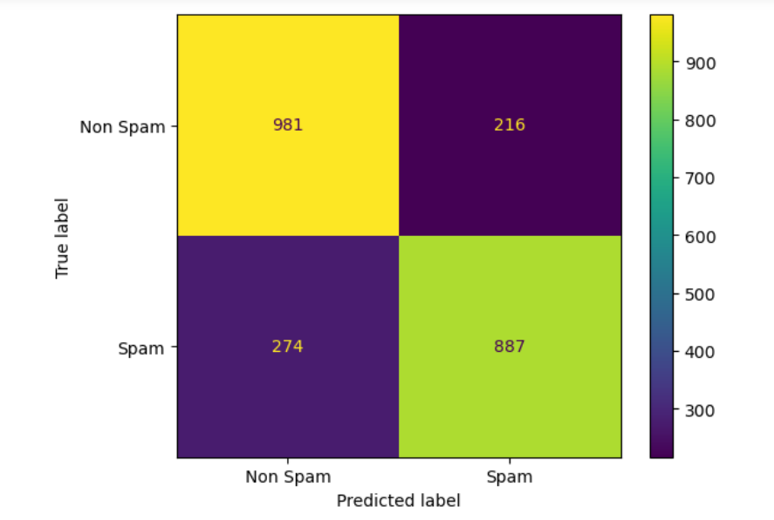

Slide 13
LARGE LANGUAGE MODEL(LLM)
LLM is a deep learning algorithm which can perform a variety of natural language processing tasks.
It analyzes vast amounts of data by learning the patterns and connections between words and phrases.
One of the example for LLM is Open AI’s GPT-3(Generative pre-trained transformer 3) which is highly effective for handling sequential data like language.

Slide 14
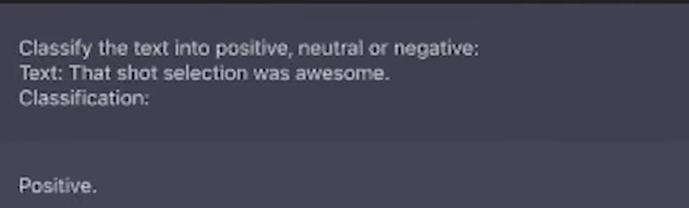
ZERO-SHOT LEARNING

Slide 15
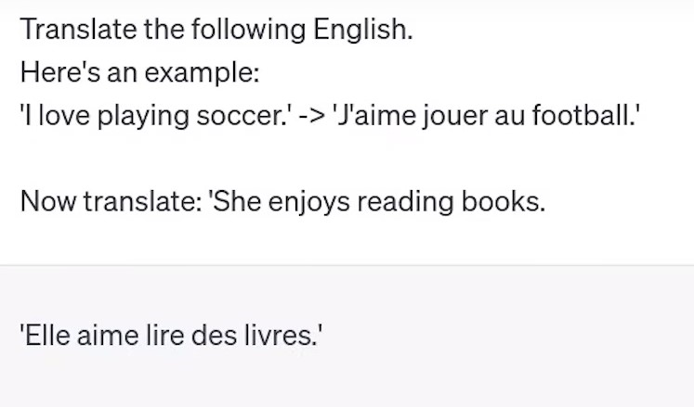
ONE-SHOT LEARNING

Slide 16
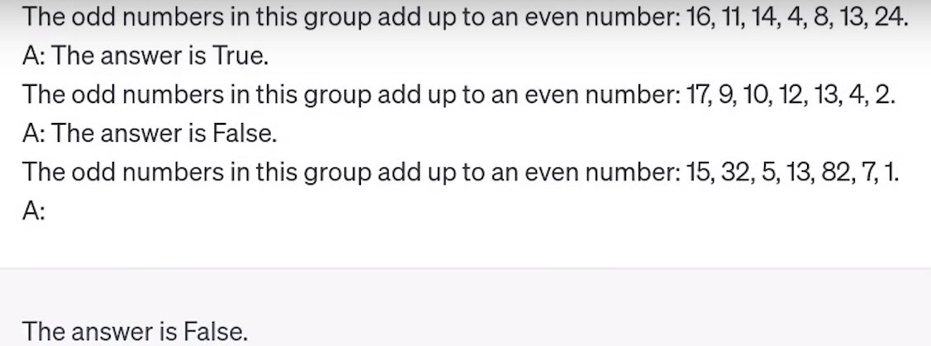
FEW-SHOT LEARNING

Slide 17
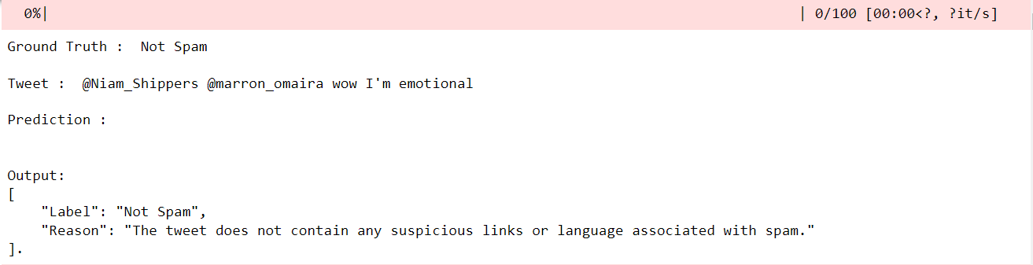
52%, 52% and 51% are the respective accuracies for zero-shot, one-shot and few-shot learning.

Slide 18
INTEGRATING LSTM WITH LLM
LSTM was more accurate in predicting the output label and LLM was more accurate in giving the correct explanation.
We tried integrating both the models to improve the overall performance.

Slide 19
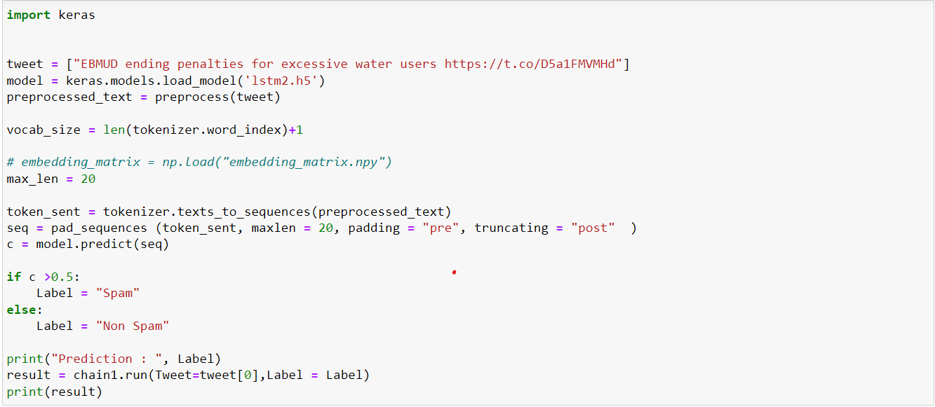

Slide 20
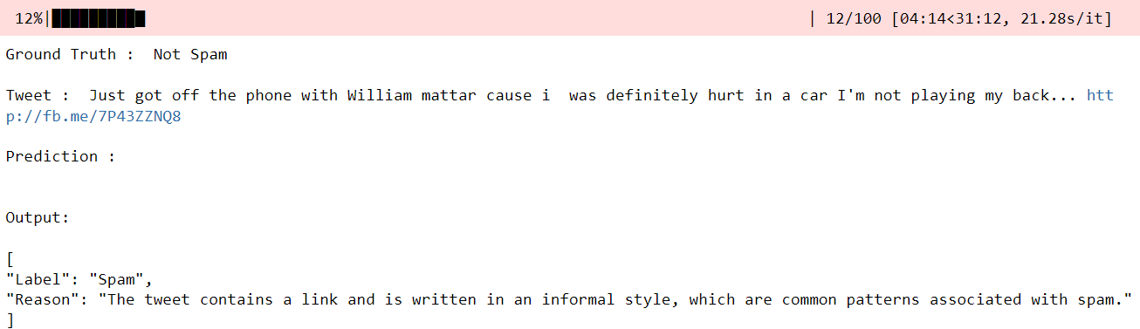
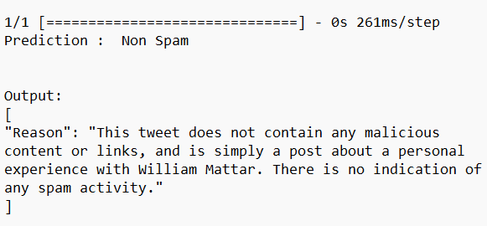

Slide 21
THANK YOU

